Slide 1
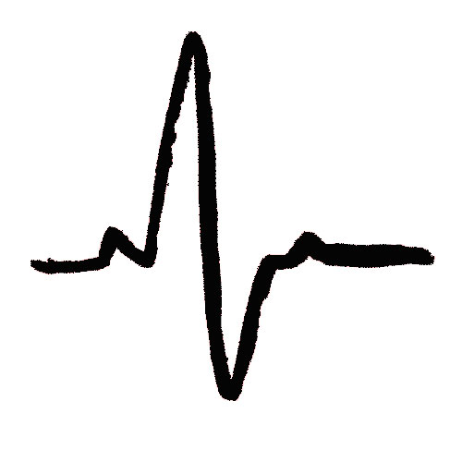

Welcome
Finding Your Political
Pulse
A nurse’s guide to legislative advocacy
Slide design by
Nursing Education & Practice
Notes:
Thank you for [Click] participating in the New York State Nurses Association’s webinar: Finding your Political Pulse: A nurse’s guide to legislative advocacy. At the end of this presentation, you will be able to describe your role as an advocate for RNs, identify past legislative victories for RNs, and apply lobbying techniques to conduct a successful meeting with your legislators.

Slide 2
Ten people…
"Injustice anywhere is a threat to justice everywhere.
~Martin Luther King Jr.
Notes:
Lobbying is an important professional activity for nurses. Nurses are experts in their field, and they can increase their legislative power by learning about healthcare policies and proposals, and can communicate their knowledge and concerns to lawmakers.

Slide 3
Why Lobby?
Form of advocacy
Influences decisions made
by governmental leaders
Helps create legislation
that benefits nursing
Increases
legislative power
Notes:
Lobbying is a form of advocacy with the intention of influencing legislative and policy decision makers. [CLICK] Any member of a democratic society has the right to lobby. For example, people like you, other constituents, and advocacy groups can lobby and attempt to influence decisions that impact healthcare.
[CLICK] Through effective lobbying, nurses can have a say in the issues that matter the most to their profession and patients. Nurses can have a say in how funds are spent including which laws are enacted, what the nursing practice environment will be, and the support of nursing education.
[CLICK] NYSNA uses lobbying as a way to advance our legislative and regulatory agenda. Let’s talk about what effective lobbying has already accomplished for nurses and patients in New York State.

Slide 4
Legislative Victories 1900-1999
1988
1972
NP Title & scope of practice legislation
1938
Legal definition of “nurse” revised
1st state in nation to require licensure
1903
State Nurse Practice Act
Notes:
The New York State Nurses Association was founded in 1901 as the nation’s first state nurses association. The association’s first initiative was the passage of a State Nurse Practice Act. [CLICK] This law was enacted in 1903 after extensive lobbying efforts by NYSNA and its members. It permitted registration of qualified nurses and created the title “registered nurse.”
[CLICK] In 1938, New York became the first state in the nation to require licensure for “all who nurse for hire.” [CLICK] The legal definition of nursing was revised again in 1972, when New York became the first state to recognize nursing as a distinct and independent health profession. [CLICK] And in 1988, the title and scope of practice for Nurse Practitioners was created.

Slide 5
Legislative Victories 2000-2007
2007
2005
Title Protection
2002
Faculty Loan Forgiveness & Scholarship Programs;
Safe Patient Handling Demonstration Program
Whistle-blower Protection
2000
SPAN –
Statewide Peer
Assistance for Nurses
Notes:
In 2000, [CLICK] the Statewide Peer Assistance for Nurses Program or “SPAN” was established to provide services to nurses with substance abuse problems. SPAN established an annual contract between the State Education Department and the New York State Nurses Association and increases access to program services for nurses.
In 2002, [CLICK] legislation known as Whistleblower Protection was enacted. This law protects healthcare workers who face retaliation for addressing issues that affect patient safety and quality of care in their workplace.
In 2005, [CLICK] the Nursing Faculty Loan Forgiveness and Scholarship programs were created to provide scholarship incentives to nursing students and faculty members in order to increase entry into the profession and make nursing education a more attractive field to pursue. Also in 2005, the legislature passed the Safe Patient Handling Demonstration Program and 1 million dollars in funding was provided. This program was designed to study the effects of safe patient handling programs in healthcare facilities across New York State.
And in 2007, [CLICK] Title Protection was enacted. This law asserts that only those licensed under the Nurse Practice Act (Registered Professional Nurses and Licensed Practical Nurses) may use the title “nurse.”

Slide 6
2008 Legislative Victory
Ban on Mandatory Overtime
RNs cannot be required to work beyond “regularly scheduled work hours”
RNs who refuse to work overtime cannot be charged with patient abandonment
Notes:
In 2008, the ban on Mandatory Overtime was a huge victory for nurses in New York State.
This applies to nurses who provide direct patient care in all practice settings, with the exception of home care.
The law…Prohibits employers from requiring nurses to work beyond their “regularly scheduled work hours”.
[CLICK] It affirms that RNs who refuse to work beyond their regularly scheduled hours cannot be charged with patient abandonment.

Slide 7

2009 Legislative Victory
Nursing Care Quality Protection Act (“Disclosure”)
Nursing staff levels & quality outcomes must be disclosed
Informs public & allows
consumers to compare quality of care
Notes:
In 2009, the Nursing Care Quality Protection Act (also known as Disclosure) was passed. [CLICK] This law requires that facilities disclose their nursing staff levels and outcomes on specific nursing quality indicators to the state. This provides the public with information regarding staffing levels and allows consumers to take a comparative look at hospitals in order to make informed decisions about where they receive their care.

Slide 8

2010 Legislative Victories
Family Health Care Decisions Act
Healthcare decisions can be made for patients that lack capacity and without prepared advance directives
Image Source: Ray Ng for TIME Magazine
Notes:
In 2010, the Family Health Care Decisions Act was passed. This act allows family members, or a close friend, to make healthcare decisions on behalf of patients who lose their ability to make such decisions, but who have not designated a healthcare proxy or prepared advanced directives regarding their care.

Slide 9
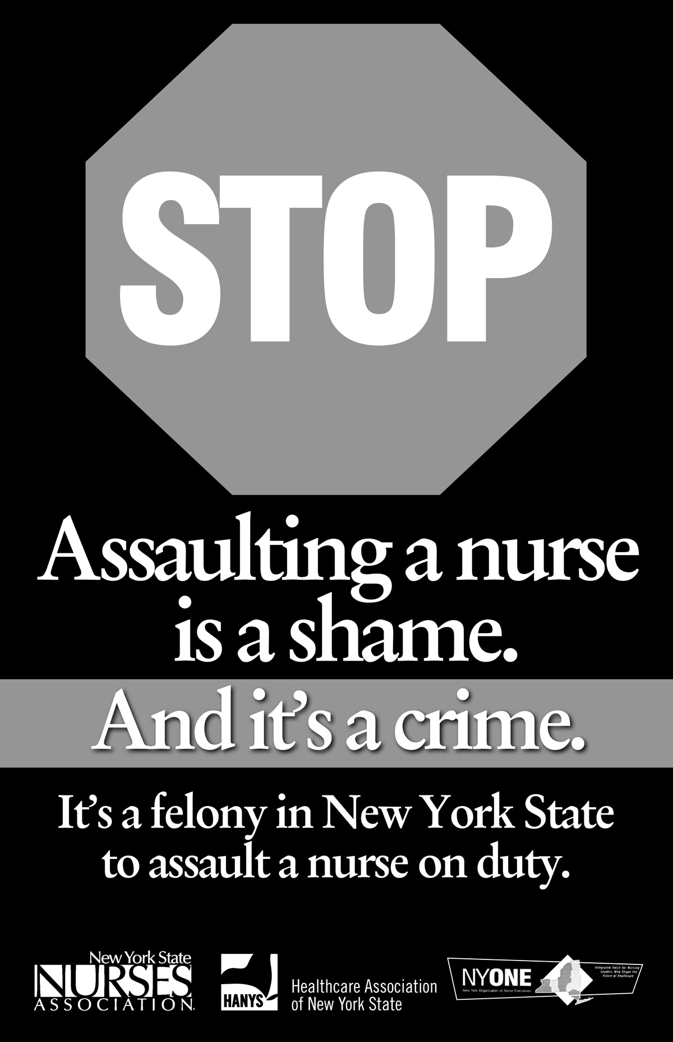
2010 Legislative Victories
Addressing Violence Against Nurses
It’s a felony in NY to assault a nurse on duty.
Became law November 1, 2010
Notes:
Another significant victory for nurses came in 2010 when the bill passed that addressed violence against nurses. Similar to assaulting a firefighter, police officer, EMT or physician, this law now makes it a felony to assault a nurse while on duty.

Slide 10
NYSNA’s Legislative Priorities
Safe Staffing
Minimum
nurse-to-patient ratios; minimum nursing care hours
Safe Staffing for Quality Care
Safe Patient Handling
Statewide
union support
Notes:
Every legislative session, NYSNA members participate in establishing the top legislative priorities for the association. In the 2013 legislative session, NYSNA’s primary focus will be on these issues: Safe Staffing and Safe Patient Handling.
[CLICK] The Safe Staffing for Quality Care Act establishes minimum staffing ratios in acute care facilities and sets minimum nursing care hours in nursing homes. There is statewide union support for this bill.

Slide 11
NYSNA’s Legislative Priorities
NYSNA’s Legislative Priorities
Safe Patient Handling
Facilities must implement policy to reduce
manual lifting
Safe Staffing for Quality Care
Safe Patient Handling
Statewide
union support
Notes:
The Safe Patient Handling bill sets up a statewide work group to make recommendations on safe patient handling policies to be implemented by healthcare facilities. The goal is to reduce manual lifting and decrease injuries to both patients and caregivers. This bill also has statewide union support.

Slide 12
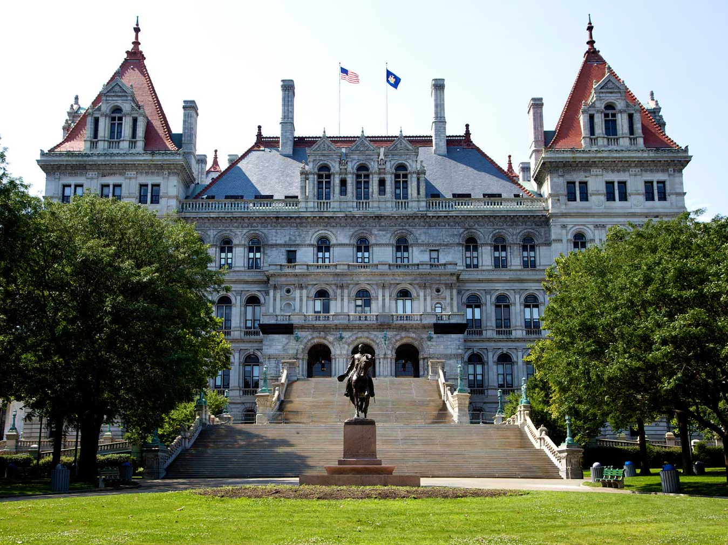
How can I get involved?
How can
I get involved?
Notes:
You may be wondering…How can I get involved?
Let’s start with some basics

Slide 13
Who’s Who in Albany
3 Branches
State Government Structure
Executive
Judicial
Legislative
20 Departments
Senate
Assembly
The Courts
63 Members
150 Members
Including Governor’s Office
Represent YOU
Notes:
New York State Government is made up of three branches: [CLICK] the Executive Branch, Judicial Branch, and the State Legislature.
The Executive Branch [CLICK] consists of 20 different departments, including the Governor’s Office. The Governor of New York is the state’s chief executive and is charged with a number of responsibilities such as the submission of the state’s executive budget, execution and enforcement of state laws and Commander-in-Chief of New York’s military forces.
The Judicial Branch [CLICK] consists of a range of courts (from trial to appellate) with various jurisdictions (from village and town courts to the State's highest court — the Court of Appeals).
The legislative branch consists of two houses of the legislature [CLICK] - a Senate of 63 members and an Assembly of 150 members. The number of legislative members is determined by the census every 10 years. [CLICK] Together, these legislators represent the voters of New York State. State legislators serve two-year terms of office and are elected in even-numbered years.

Slide 14
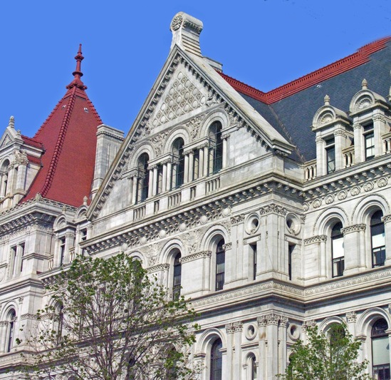
Functions of State Legislature
Make laws
Pass an annual
state budget
Review administrative actions by state agencies
State Senate can confirm or reject nominations
for certain offices
Notes:
The primary function of the state legislature is to [CLICK] make laws. Another important function is to either [CLICK] pass or revise the Governor’s annual budget. The legislature also [CLICK] reviews administrative actions by state agencies to ensure that they conform to legislative intent and authorization.
[CLICK] The State Senate has authority to confirm or reject nominations made by the Governor for certain state and judicial offices.

Slide 15
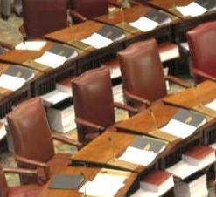
House Leaders
Senate Majority Leader
Speaker of the Assembly
Controls functions of the Senate
Appoints
chairpersons for standing committees
Controls functions of the Assembly
Appoints
chairpersons for standing committees
Examples of standing committees:
Health Committee, Higher Education Committee, Labor, Codes, Finance, Rules, etc.
Notes:
Both the Senate and Assembly have a leader that controls most of the functions of their house – The Senate Majority Leader and the Speaker of the Assembly. Additionally, both leaders appoint chairpersons for standing committees in their house. [CLICK] Some examples of standing committees are Health Committee, Higher Education Committee, Labor, Codes, finance, rules, etc.

Slide 16
How a Bill Becomes a Law
Idea for bill is presented
Bill is drafted
Bill is introduced
& assigned a number
Bill is
referred to a committee
Bill is debated
& voted on by one house
Bill is introduced to the other house
Bill is reviewed by committee(s) in 2nd house
Bill is debated
& voted on by other house
If passed, bill is sent to the Governor
Notes:
To become law in New York State, a bill must pass both houses of the State Legislature--- the Assembly and the Senate– then it gets sent to the Governor for his or her signature.
[CLICK] Ideas for laws come from many sources – constituents, legislators, officials, and interest groups. To be considered by the Assembly or Senate, [CLICK] the idea’s champion works with a legislator and the Legal Services Department of the Legislative Bill Drafting Commission to have a bill drafted, following certain formatting and legal requirements. When a bill is introduced [CLICK] by its sponsor into the Assembly or the Senate, a bill number is assigned. Bills in the Assembly have an “A” at the beginning of their number; Bills in the Senate have an “S”. The bill is identified by this number throughout the 2-year legislative session.
[CLICK] Next, the bill is referred to an appropriate committee for consideration. When the bill addresses more than one area of interest, it may be considered by multiple committees. Any bill that requires state expenditure must go to the Assembly Ways & Means Committee or the Senate Finance Committee. The Rules Committees, chaired by the Majority Leader in the Senate and by the Speaker in the Assembly, influence the flow of legislation and near the end of legislative session, all bills must go through the Rules Committee. If a bill is never placed on a Committee agenda to be considered and reported out, it is said to have “died” in committee. [CLICK] After all the committees have favorably considered (or “reported out”) the bill, it has to “age” for at least three legislative days, and then can be scheduled for a floor vote. [CLICK] When a bill passes in one house, it is sent to the other house for consideration through [CLICK] a similar committee process.
[CLICK] The bill is then debated in the other house and [CLICK] if passed, the primary sponsor sends the bill to the Governor.

Slide 17


Once the bill is reviewed by the Governor….
The bill is
signed into law
2/3 majority in both houses can override veto
or
Bill is vetoed and dies
Bill becomes
a law
Notes:
Once the bill is reviewed by the Governor, a few different things can happen. The Governor can either approve the bill by signing it (also called making it a “chapter”) or [CLICK] the Governor can disapprove the bill by vetoing it. If the bill is vetoed, [CLICK] the Legislature may override the veto by two-thirds majority vote of each house. [CLICK] If the Governor’s veto is overridden, the bill would then become a law.

Slide 18


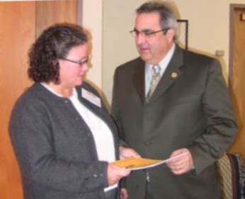
Getting Your Message Across
Letter Writing
Electronic Mail
Office Visits
Effective Communication
is KEY
Notes:
Nurses must use their expertise about nursing and health care to educate elected officials so they will make informed decisions about which bills to sponsor and which bills to support.
NYSNA provides lobbying packets on a variety of nursing issues to help you understand pending legislation. The packets include bill numbers, sponsors, and talking points you can use in writing or speaking to lawmakers. Effective communication is key.

Slide 19

Letter Writing
Address one subject line per letter
State your request clearly
Identify yourself as an RN and constituent
Identify bill # and list reasons you support/oppose
Provide examples of the impact of legislation
Request a response to your communication
Send copies to chairperson of committee, majority and minority leaders
Notes:
Writing a letter is still an effective means of communication. Legislators regularly review their correspondence. Following these guidelines will increase the chance of your letter being read and understood. [CLICK] Address ONE topic per letter– changing topics from one to another could get confusing for the person reading your letter. Be clear. [CLICK] And always [CLICK] make sure to identify yourself as a constituent and as an RN. [CLICK] Identify the bill by number and list your reasons for either supporting or opposing it and make sure to [CLICK] provide examples of the impact of the legislation. [CLICK] You should also request a reply to your letter and be certain to [CLICK] send copies to the chairperson of the committee, as well as to majority and minority leaders.

Slide 20

Electronic Mail (e-mail)
Message
  Bill # in subject line
  Clear request of action; your “ask”
  You are an RN and constituent
Follow-up
  Your name and phone number
  Contact office within 2 weeks
Notes:
As we all know, e-mail is a common means of communication. All state legislators have email addresses that are listed on the State Assembly and Senate websites. [CLICK] When sending an e-mail, use the bill number in the subject line so the reader knows exactly what bill will be discussed in the e-mail. Like writing a letter, state your position briefly with a clear request of action, also known as your “ask”, and give examples of the impact the legislation. Always remember to identify yourself as a constituent and a registered nurse. [CLICK] Include your full name and phone number for follow-up with the legislator. We also suggest following up with the office within two weeks to see how your request of action is being handled.

Slide 21


Office Visits
Schedule an appointment
Research the issue
Recruit others
Listen carefully
Don’t worry
Meet the staff
You can always follow-up.
Notes:
The first step to planning an office visit is setting up the appointment. [CLICK] You want to make sure you call a few weeks in advance to schedule a meeting. Before meeting with your legislator, you always want to make sure to do your leg work. [CLICK] Research the issue that you want to discuss with them and the status of the legislation in question. You can contact NYSNA for help with this. Feel free to invite colleagues to your meetings as well.
When meeting with your legislator, make sure to identify yourself as a registered nurse and a constituent. [CLICK] Listen carefully to the legislator’s views and note any concerns that are raised. If the legislator has questions that you cannot answer– don’t worry. [CLICK] You can always follow up with the answers later. After meeting with the legislator, ask to meet staff. [CLICK] Ask who the contact is for health care issues in his or her office. Sign the guestbook in the reception area and don’t forget to sign RN after your name. When leaving, always thank the legislator and leave your contact information and any printed materials you may have on the topic. We also suggest following up with the office within two weeks to thank them again and to see how your request for action is being handled.

Slide 22
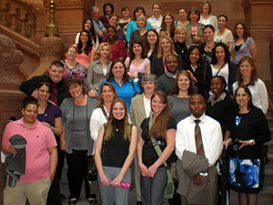
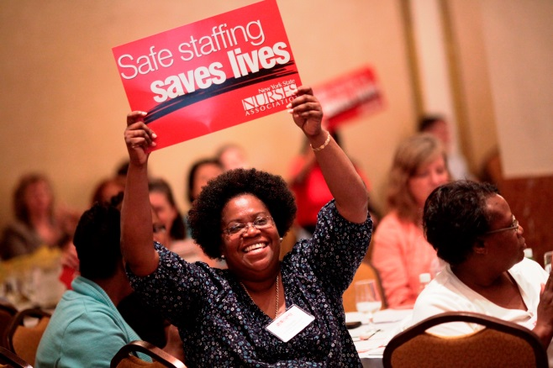
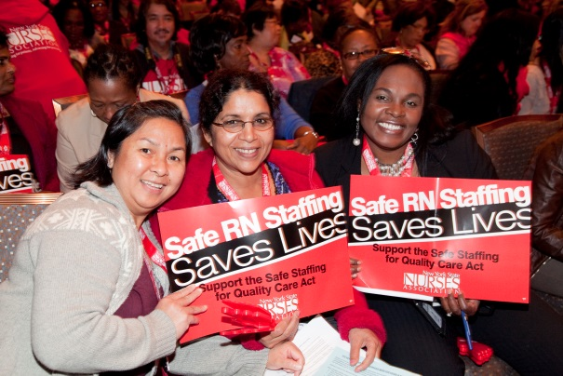
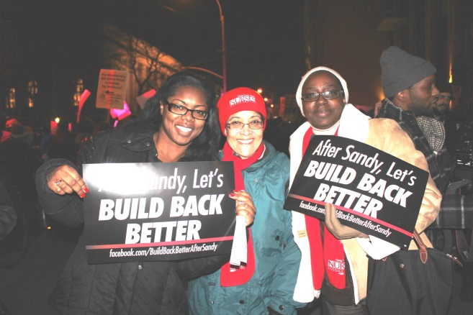

Get Involved!
Attend NYSNA’s April 16th Lobby Day
at the Capitol
Attend the multi-union Healthcare Workers Lobby Day/Rally on May 21st at the Capitol
Visit your legislators in their district offices
Notes:
NYSNA has a lot of different ways for you to get involved.
[CLICK] You can attend NYSNA’s April 16th Lobby Day in Albany, you can also attend the multi-union [CLICK] Lobby Day on May 21st in Albany, you can attend one of NYSNA’s local rallies and [CLICK] you can visit your legislators in their district office.

Slide 23
Thank You!
Questions?
Contact Political and Community Organizing by:
  Phone: 800-724-6976 x 283 (within New York)
  518-782-9400 x 283 (outside New York)
  Email: legislative@nysna.org
  Website: www.nynsa.org
Locate legislators’ contact information at www.congress.org.
get involved with NYSNA!
Notes:
Thank you for participating in Finding Your Political Pulse. We hope you find this presentation helpful. If you have any questions regarding the information you heard today, please contact us.
If you need help finding your legislator’s contact information, you can find it at www.congress.org.
[CLICK] We hope you get involved with NYSNA soon!

